Slide 1
ISOTYPE Visualization - Working Memory, Performance and Engagement with Pictographs
Joey Trull JOUR 77D

Slide 2
ISOTYPES & Pictographs
ISOTYPE = International System of TYpographic Picture Education
uses simple pictographic elements to show data
defined in 1920
intended for universal communication of quantities of social/economic/commercial
first designs used symbols stacked representing an amount/number and stack showing total
another method is to stretch one symbol to the length/height of the total

Slide 3
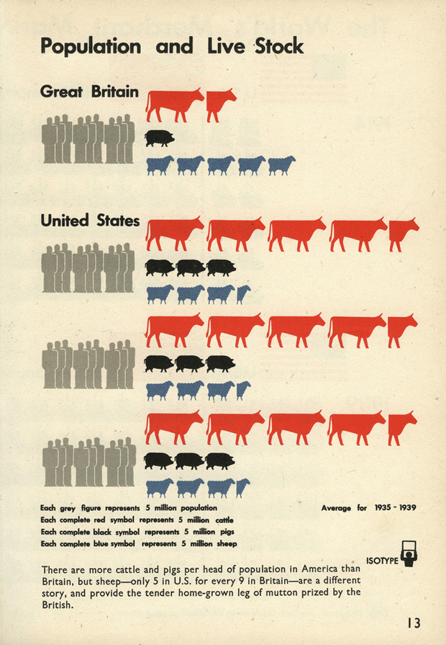

Slide 4
Overview
researchers from Northwestern University and Tableau wanted to test usefulness of pictographs and whether they were “chart junk”
tested simple charts to see pictographics effect in terms of 1.) memory 2.) speed of gaining info 3.) engagement with visualization

Slide 5
pictograph vs. simple shapes: created black/white SVG pictographs to compare against column/bar
stretched vs. stacked:
found that stacking is better because presents number of objects and as a height
Pictograph vs. text axis labels: tested whether a pictograph should be used or just plain text

Slide 6
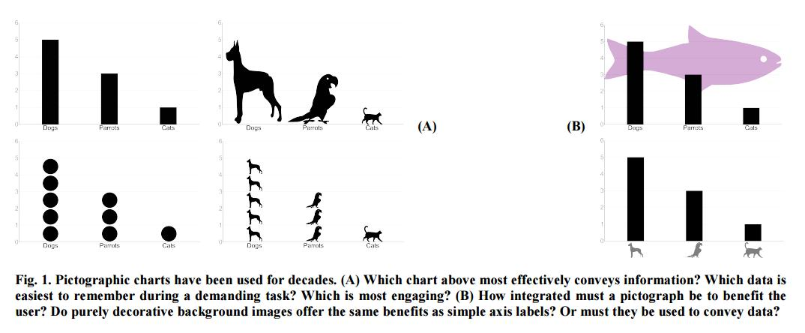

Slide 7
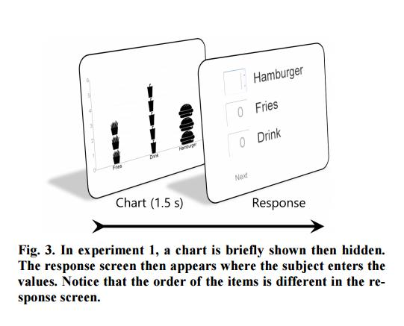

Slide 8
Experiment 1
tested undergraduates, 200 trials in lab
used chart with 3 values (range 1-5) for 1.5 sec, then asked to respond on next screen what they saw
to show memory of values and not graph overall, answers were not in same order
5 charts to test all variables (stacked, pictograph vs. shape, bar w/ superfluous image and axis with pictograph or text)
Results: 1.) pictographs vs. shapes (no difference) in memory 2.) stacked was better than stretched (cited redundant coding of length and number have improved memory) 3.) axis (for all types of charts tested, pictographic labels increased error rate) 4.) superfluous pictograph (embellishment that did not encode data dramatically increased error rate)

Slide 9
Experiment 2
instead of 1-5 range, used 1-5, 2-10 and 3-15
left all labels as text this time (based on Exp. #1 results)
omitted the superfluous pictograph test
limited students on campus at time, used people on Amazon’s Mechanical Turk
--5 range showed similar to lab results of Exp. #1
stacking again improves performance but less so at higher values

Slide 10
Experiment 3
Tested memory when memory is more clouded than focused on just the values show; tested in lab
testing since info is lost when given new sets of info after
tested to see if pictures help recall the information vs. just the value when given new info after as well
all labels were text and excluded superfluous pictograph
1-5 range, participants shown multiple charts and asked to recall them starting from the 1st chart
found less error when pictographs were used
but stretched vs. stacked no longer had a clear winner like experiments before

Slide 11
Experiment 4
tested speed and performance to see if pictographs were faster but noted that in Exp. #1 we learned that text axis labels were faster
3 values in chart with 1-5 value range
2 pictographs also at top of screen, with text asking which of these has more in the graph
timed the responses
used Amazon Mechanical Turk again
200 trials resulted in 92% accuracy
showed only the superfluous image charts slowed down performance; this + Experiment 1 = “superfluous images hurt both memorability and speed of usability of charts.”

Slide 12
Experiment 5
instead of speed, wanted to test for times when wanting views to pause and look
questioned will it gather more attention than a bar chart?
participants shown 3x3 grid thumbnails
shown short title + slightly blurred thumbnail of a chart in each section of grid
given 2 min. to look, click around on any thumbnail for full, unblurred charts without limit on number of clicks
paid students in lab
2/3rd of views in the first 15 sec. of test were pictograph charts choices, then viewers move on to the others
-highly effective at attracting attention and engagement

Slide 13
Learned and suggested guidelines:
1.) Superfluous pictographs are a distraction. -no impairment unless used without data representation
2.) Redundantly code length and number -use gridlines when using bar/column to go with length
3.) Use pictographs for demanding tasks -recalled more accurately than simple bar charts
4.) Pictographs engage readers -can be combined with other elements (like text) because they draw attention
Conclusion: Pictographs are not “chart junk”

Slide 14
http://steveharoz.com/research/isotype/

